Slide 1

Software Engineering
The Zen of Project Planning
Harald Drillenburg
Year 2 2nd term

Slide 2
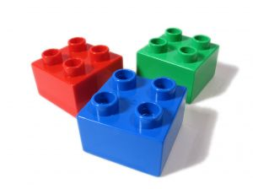
Course structure
Principles of Software Engineering
The zen of project planning
Developing under architecture
Designing with patterns
Testing and continuous integration
Test Driven Development
Architecture in Agile projects
Year 2 2nd term

Slide 3



Questions during class!
Jaar 2 Kwartaal 1

Slide 4
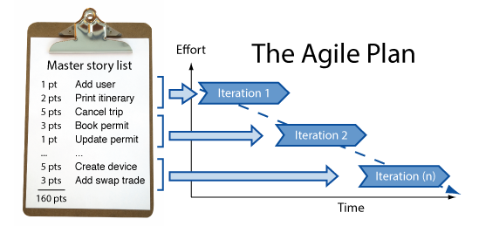

Discussion: project plan for EPD
Year 2 2nd term

Slide 5
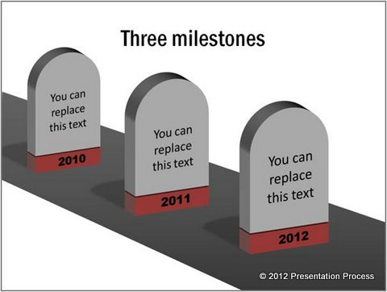
Milestones
A major release
Can be used for real
Customer will pay for this
Year 2 2nd term

Slide 6
Different way of prioritizing
MoSCoW
  There’s the 20-20-30-rest rule to abide by
Priorities 10-20-30-40-50-60
  Not 1-2-3-4-5-6!
  Why?
Dividing 100 (1000) points over the user stories
  No user story gets the same amount
  Real risk of ordering instead of prioritizing
Year 2 2nd term

Slide 7
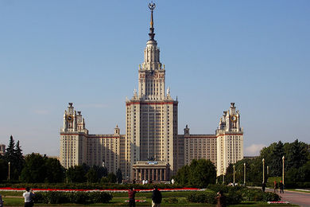

MoSCoW
Acronym for:
  Must Have
  Should Have
  Could Have
  Would like to have (but not this time around)
Rule: 20 / 20 / 30 / rest
  So max 20% is Must
  Max 20% is Should
  Max 30% is Could
  The rest is in Would
  You do NOT get more room in S by using less in M!
Year 2 2nd term

Slide 8
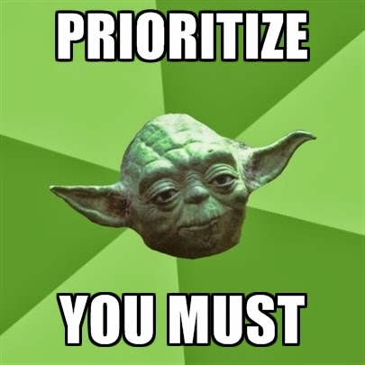
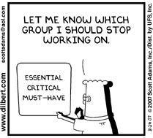
Prioritize and reprioritize
Year 2 2nd term

Slide 9
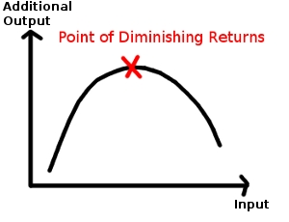
Just add more developers?
Law of diminishing returns
Year 2 2nd term

Slide 10


Exercise: prioritizing
Take the initial list of requirements for the privacy case study
Pick a prioritization method you think is best
Assign priorities
Year 2 2nd term

Slide 11
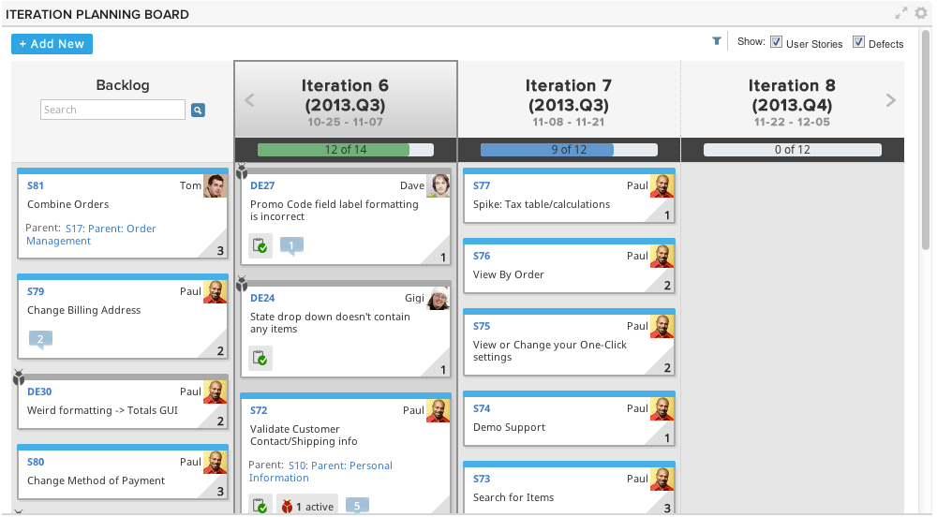
Iteration board
Year 2 2nd term

Slide 12
Exercise: create an iteration board
Take the case study again
Create an iteration board, using all input you by now created
Year 2 2nd term

Slide 13

Reality check
Your developers do more than work 24/7:
They get sick
Have family issues
Have days off
Get bogged down in interfering stuff
Turn out having to study some stuff in order to proceed
And the world around us is not always cooperating
either:
Software having problems
Getting stuck in traffic
Year 2 2nd term

Slide 14
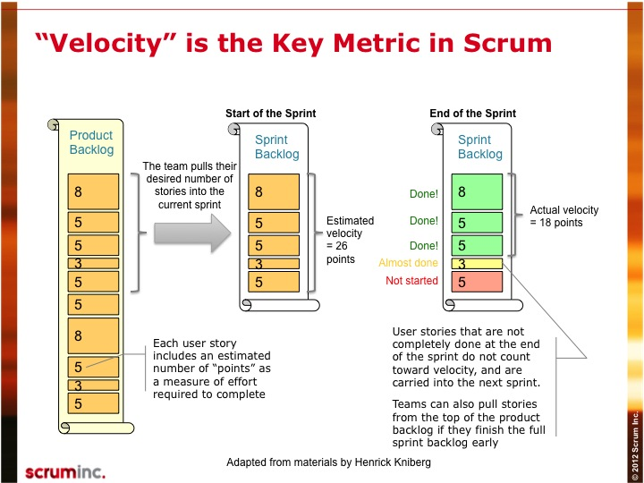
Enter velocity
Velocity here is
18/26= 0,7
If the next
iteration has
an estimate of
30 days work, it
will actually
take 30 / 0,7 =
43 days!
Year 2 2nd term

Slide 15
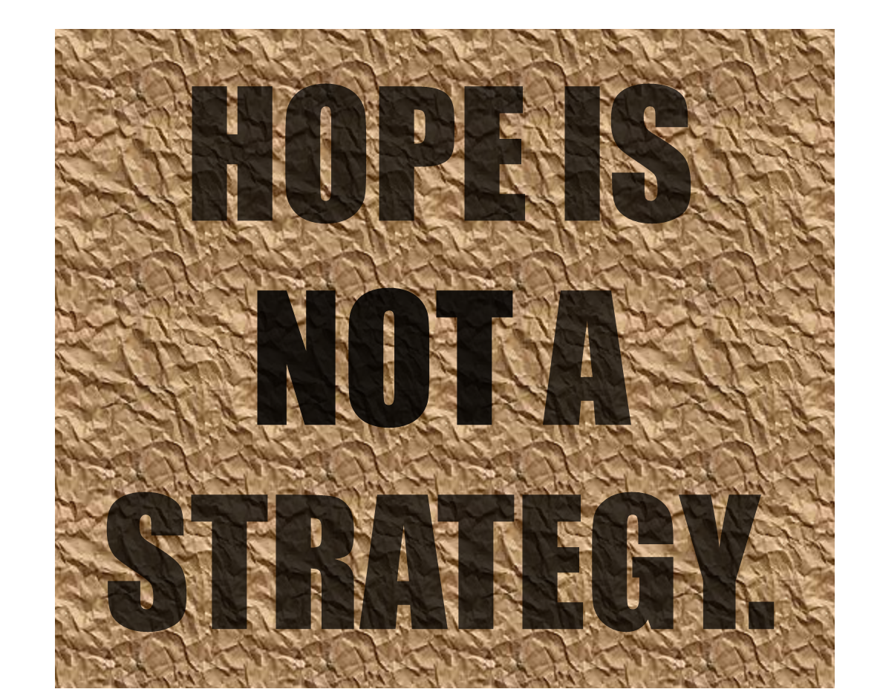
Programmers vs software engineers
Programmers think in Utopian days
Software Engineer plan in real world days
Year 2 2nd term

Slide 16
Exercise: adjust the iteration board
Adjust the iteration board created in the
previous exercise, using velocity
Year 2 2nd term

Slide 17
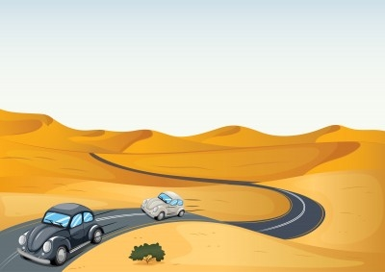
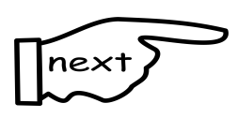
Tips when dealing with velocity
Take velocity into account before you break into iterations
Velocity is not a way to squeeze in more work or added whishes!
Velocity is a planning
tool, not a tracking
mechanism
  That would be the
  burn-down rate
Year 2 2nd term

Slide 18
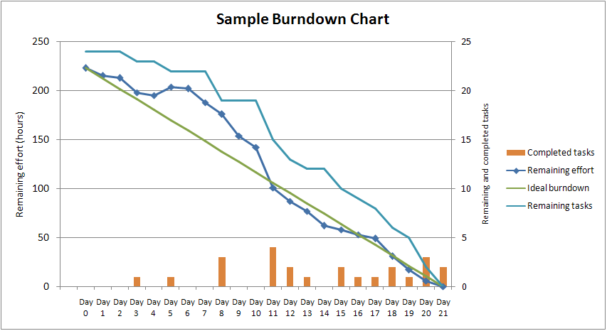
The burn-down rate
Year 2 2nd term

Slide 19
Exercise: assigning work
Determine what roles (specialists) this project would need, for example:
  Database specialist
  Mathematician
  GUI guru
  Software developer
Assign those roles to group
members
Assign the user stories
from the first iteration to
a group member
Year 2 2nd term

Slide 20
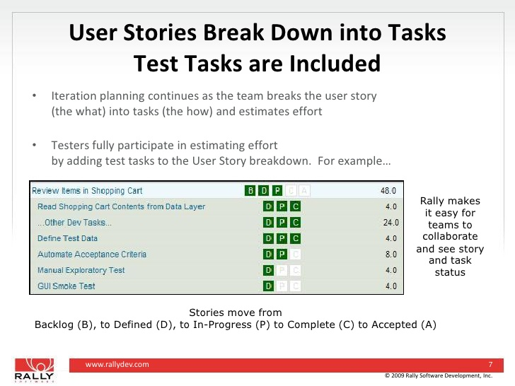
Breaking stories into tasks
User stories describe functionality
Tasks are what is to be done in order to implement this functionality
Year 2 2nd term

Slide 21
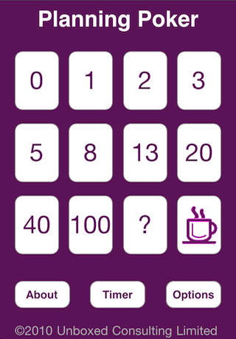
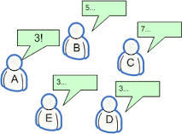
Planning poker on tasks
Year 2 2nd term

Slide 22

Improving your iteration board
Take the board from page 116 + 117 from the text book as an example
Create a new board for the privacy case study
Break your work into tasks
Play planning poker on it
Divide the work amongst the group members
Year 2 2nd term

Slide 23
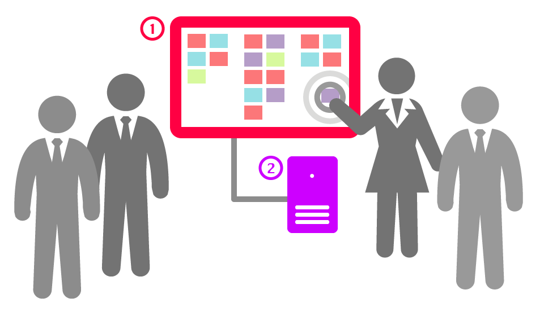
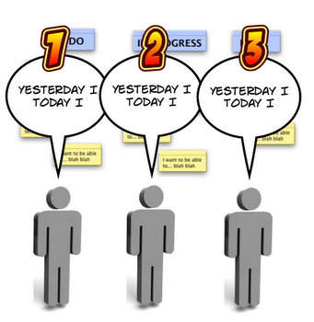
Stand-up meetings
Year 2 2nd term

Slide 24
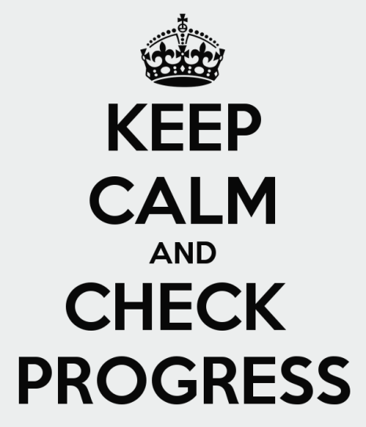
Track your progress
Track your progress
A task is only in progress if it’s in progress
There’s no such a thing as ‘90% complete’
Tasks are only moved to the ‘Complete’ box when they are complete and tested
Burndown rate is a major tool in tracking
progress
Year 2 2nd term

Slide 25
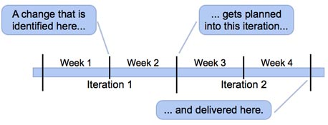
Unplanned tasks and requests
Unplanned tasks and requests should be entered into the planning ASAP
Try moving them to the next iteration(s)
If that’s not possible, reprioritize
Year 2 2nd term

Slide 26
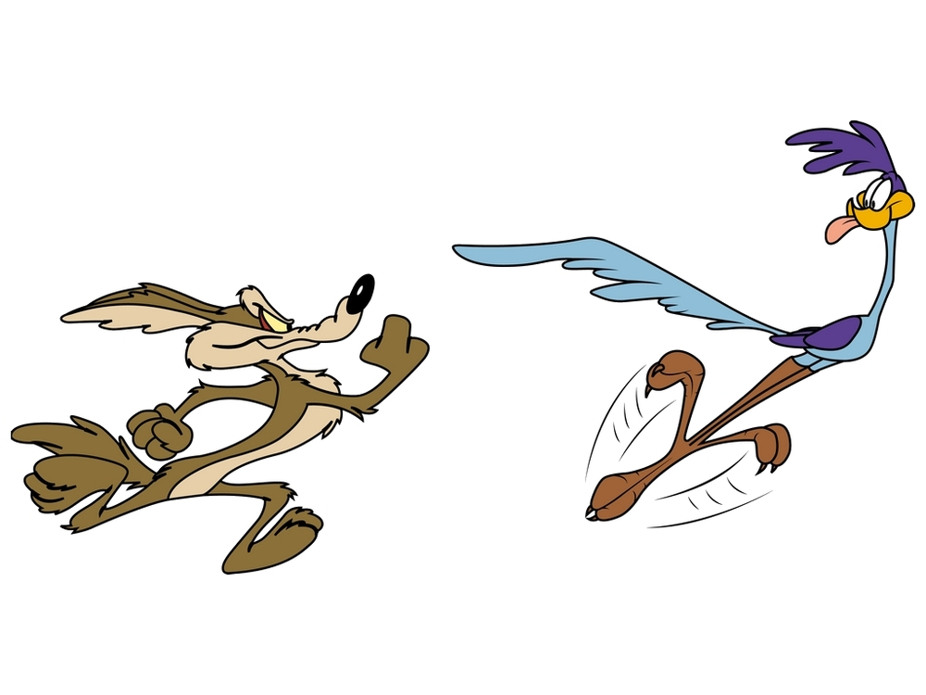

Don’t abuse velocity!
It’s a planning tool, not a way to squeeze in more work
Year 2 2nd term

Slide 27

Exercise
Create an iteration board for the EPD case study
Break down the user stories into tasks
Assign roles to the group members
Play planning poker on the tasks
Assign tasks to members
Year 2 2nd term

Slide 28

Homework
Read Chapter 3 and 4 from the textbook
Do the exercises intermingled in the book
Finish the exercises
Year 2 2nd term

